Slide 1
APUSH Review: Key Concept 3.1
Period 3: 1754 – 1800
Everything You Need To Know About Key Concept 3.1 To Succeed In APUSH
Updated for the 2015 revisions

Slide 2
The New Curriculum
Key Concept 3.1 “British attempts to assert tighter control over its North American colonies and the colonial resolve to pursue self-government led to a colonial independence movement and the Revolutionary War.”
Page 36 of the Curriculum Framework
Big ideas:
How did the 7 Years’ War alter the relationship between the British and colonists?
What arguments did colonists use to resist Britain’s actions after the war?

Slide 3
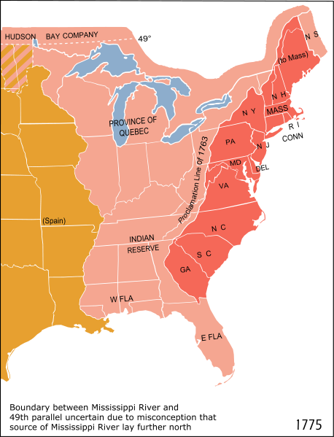

Key Concept 3.1, I
“The competition among the British, French, and American Indians for economic and political advantage in North America culminated in the Seven Years’ War (the French and Indian War), in which Britain defeated France and allied American Indians.” - Page 36 of the Curriculum Framework
A) What led to British-French conflict, and what were the impacts?
Causes:
Expansion of British colonists into the interior of North America (Ohio Valley)
Iroquois allied with the British
The French were removed from North America – lost a trading partner
British colonists expanded on to native land
Pontiac’s Rebellion -> Proclamation Line of 1763

Slide 4

Key Concept 3.1, I
B) Impacts of the war?
Britain gained MASSIVE amounts of land in North America – France is essentially removed
Britain became in debt from the war - sought to raise revenue and gain more control over colonies
Salutary Neglect Ends – Britain ends its “hands-off” approach
Britain begins to collect taxes – Sugar Act (1764), Stamp Act (1765), etc.
Tensions from the 7 Years’ War helped lead to the American Revolution
C) Post-7 Years’ War, Britain sought to limit expansion
Britain forbade expansion west of the Appalachian Mountains -> Proclamation Line
Natives resisted encroachment of colonists
Pontiac’s Rebellion (1763)

Slide 5
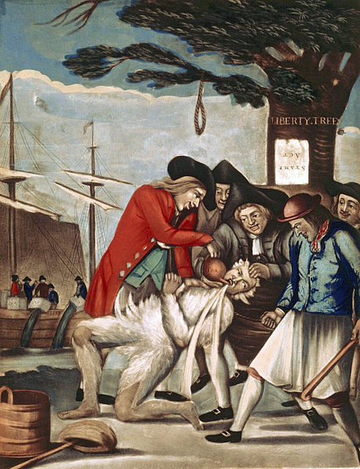
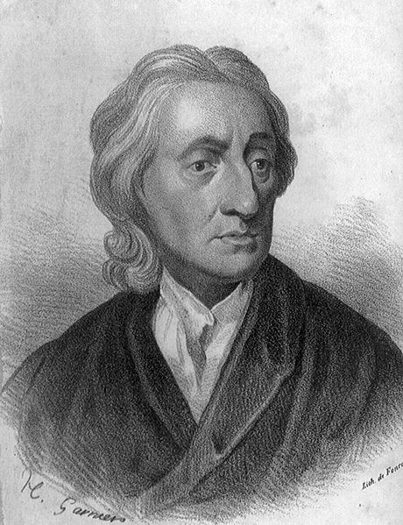
Key Concept 3.1, II
“The desire of many colonists to assert ideals of self-government in the face of renewed British imperial efforts led to a colonial independence movement and war with Britain.” - Page 37 of the Curriculum Framework
A) What united colonists AGAINST the British?
British taxes WITHOUT colonial representation or consent
Parliament created taxes without colonial representation, stated they were “virtually” represented
Colonists were ok with colonial taxes; they could vote for representation
Colonists successfully boycotted taxes (Stamp, Townshend) and they developed more resolve in their cause
B) How did colonists justify their resistance?
Rights of British subjects:
Rejection of “virtual representation” – idea that Parliament acted in best interest of all British subjects
Rights of individuals:
Taxation, writs of assistance, admirality courts
Enlightenment ideas:
Consent of the governed, “Life, liberty, and property”
Local Traditions of self-rule:
Colonists had the ability to elect colonial representatives

Slide 6
Key Concept 3.1, II
C) Individuals involved in the independence movement:
Colonial leaders:
Paul Revere and John Hancock – wealthy merchants that protested taxation
Ben Franklin – argued America contributed significantly to the 7 Years’ War through colonial taxes and men; co-writer of the Declaration of Independence, and gained the support of France during the war
Grassroots movements: laborers, artisans, and women
Mercy Otis Warren – writer that urged independence
D) Patriot Mobilization:
Large numbers of men AND women contributed to the war effort
Provided financial and material support
E) British advantages and American advantages:
British:
loyalist opposition (20% and higher in some areas)
Bigger military and more $
American:
Familiarity with the land, military leadership of George Washington, deep commitment to their cause, and foreign aid – most notably the French, after Saratoga

Slide 7
Test Tips
Multiple-Choice and Short Answer Questions:
7 Years’ War and its impacts on Native Americans
Impact of the 7 Years War (End of salutary neglect)
Essay Questions:
Political, social, and economic causes of the Revolutionary War
How can the French And Indian War be seen as a turning point in American History?

Slide 8
Short Answer Question
Remember, each part (a, b, c) must be AT LEAST 2-3 sentences.
After 1763, Britain began to consolidate its control of the British colonies
A) Briefly explain reason for this consolidation
B) Briefly explain one British action taken between 1763 and 1776.
C) Briefly explain one reaction by the colonists to the action described in part b)

Slide 9
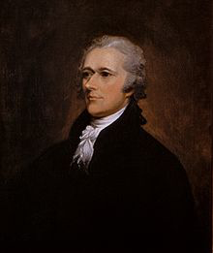
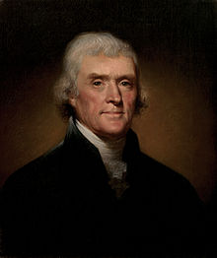
See You Back Here For Key Concept 3.2!
Thanks for watching
Please subscribe and share
Check out APUSHReview.com for many more resources
Practice Short Answer Questions and other assessments
VS

